Slide 1
THINK BIG ADVERTISING (GOA PLAN )
Notes:
NOTE:
To change the image on this slide, select the picture and delete it. Then click the Pictures icon in the placeholder to insert your own image.

Slide 2
www.thinkbig.pw
OUR CLIENTS
Notes:
NOTE:
To change the image on this slide, select the picture and delete it. Then click the Pictures icon in the placeholder to insert your own image.

Slide 3
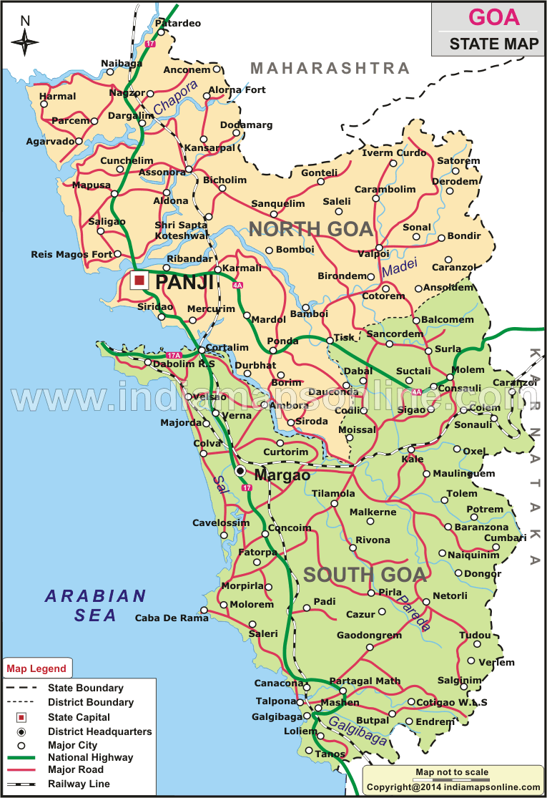
www.thinkbig.pw
Goa map

Slide 4
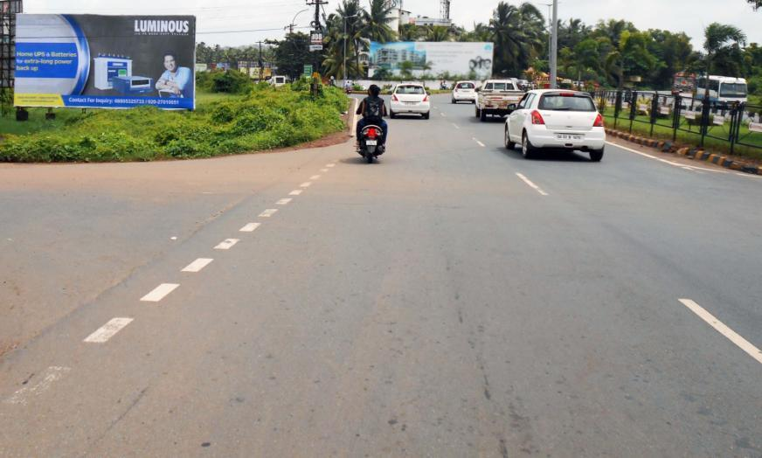
Mapusa city entrance (near green park hotel) ftf Panjim to Calangute, Maharashtra (40x20)
Billboard Rationale
High Traffic Junction, visible to traffic entering from
Panjim city and Porvorim moving on NH17 from Mumbai, Colvale, Pernem, Tivim, Bicholim etc towards Mapusa city.
* (Site very close to Green Park Hotel, Eicher Showroom, Bhingis restaurant , etc)
Notes:
NOTE:
To change the image on this slide, select the picture and delete it. Then click the Pictures icon in the placeholder to insert your own image.

Slide 5
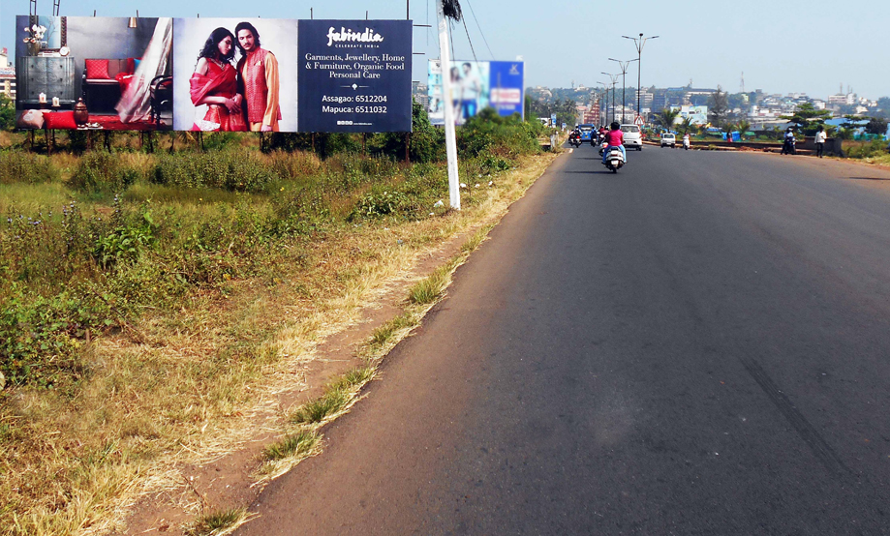
Mapusa city entrance (70x20)
Billboard Rationale
High Traffic Junction, visible to traffic entering into Mapusa city also moving on towards Colvale, Pernem, Tivim, Bicholim etc from Panjim city, Porvorim and Guirim.
* (Site very close to Bodgeshwar temple, Eicher showroom, Green Park Hotel)
Notes:
NOTE:
To change the image on this slide, select the picture and delete it. Then click the Pictures icon in the placeholder to insert your own image.

Slide 6
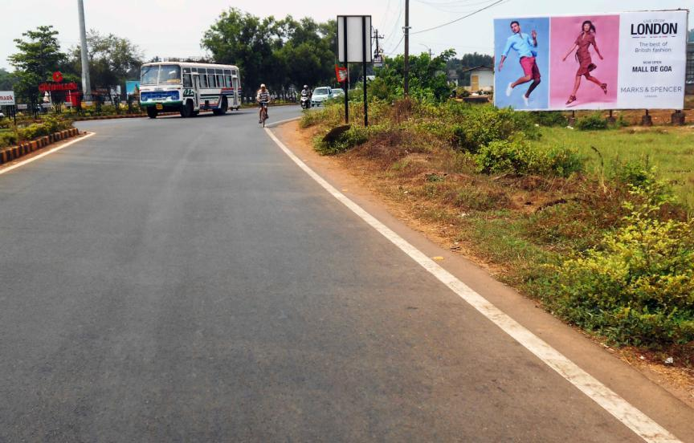
Mapusa (near green park hotel) to Panjim(40x20)
Billboard Rationale
High Traffic Junction, visible to traffic entering from Mapusa city, moving on NH17 from Mumbai, Colvale, Pernem, Tivim, Bicholim etc towards Panjim city and Porvorim.
* (Site very close to Green Park hotel, Eicher showroom, Bhingis restaurant , etc)
Notes:
NOTE:
To change the image on this slide, select the picture and delete it. Then click the Pictures icon in the placeholder to insert your own image.

Slide 7
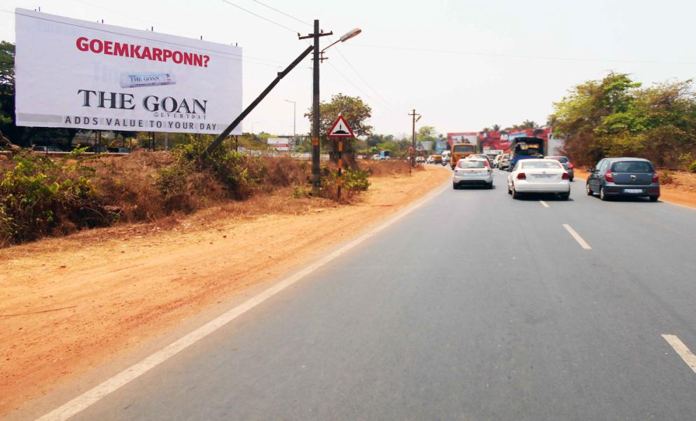
Porvorim (opp. petrol pump) ftf Mapusa, Calangute / Baga / Candolim / Saligao etc to Panjim (42x20)
Billboard Rationale
High Traffic Area, visible to traffic entering into Panjim city and Porvorim from Mapusa city, Calangute, Baga, Candolim, Sangolda, Mumbai, Colvale, Pernem, Tivim, Bicholim etc.
* (Site very close to Delfino’s supermarket, Maruti Sai Service & Hero showroom, Neo Majestic Casino, Petrol pump & IHM College)
Notes:
NOTE:
To change the image on this slide, select the picture and delete it. Then click the Pictures icon in the placeholder to insert your own image.

Slide 8
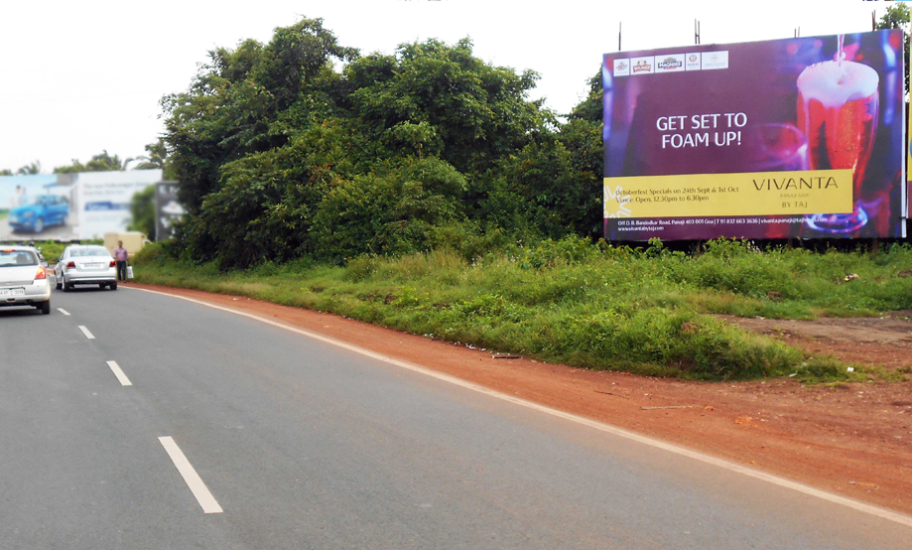
Porvorim (near petrol pump) ftf Mapusa, Calangute / Baga / Candolim / Saligao etc to Panjim (30x20)
Billboard Rationale
High Traffic Area, visible to traffic entering into panjim city and porvorim from mapusa city, Calangute, Baga, Candolim, Sangolda, Mumbai, Colvale, Pernem, Tivim, Bicholim etc.
* (Site very close to Delfino’s supermarket, Maruti Sai Service & Hero Showroom, Neo Majestic Casino, Petrol pump & IHM college)
Notes:
NOTE:
To change the image on this slide, select the picture and delete it. Then click the Pictures icon in the placeholder to insert your own image.

Slide 9
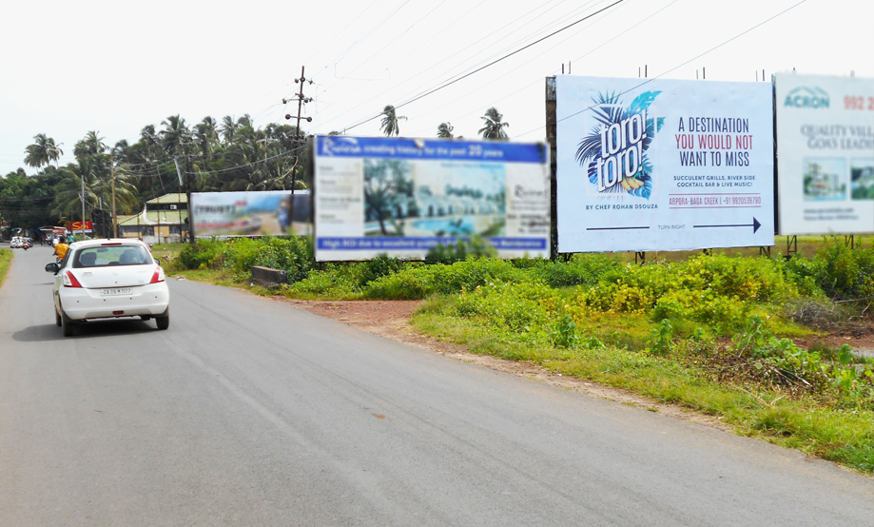
Calangute entrance
(from Arpora ftf Anjuna to Candolim) (30x20)
Billboard Rationale
High Traffic North Goa Tourist Area, visible to traffic & pedestrians entering into Baga Beach, Calangute Beach, Candolim Beach, Sinquerim Beach from Anjuna, Vagator, Chapora, Siolim etc.
* (Site very close to Club Cabana, Saturday Night Market, Titos, 3 star – 4 star properties such as Marina Dourada, Sunvillage, popular restaurants such
as Brittos, Little Italy, Souza Lobo etc)
Notes:
NOTE:
To change the image on this slide, select the picture and delete it. Then click the Pictures icon in the placeholder to insert your own image.

Slide 10
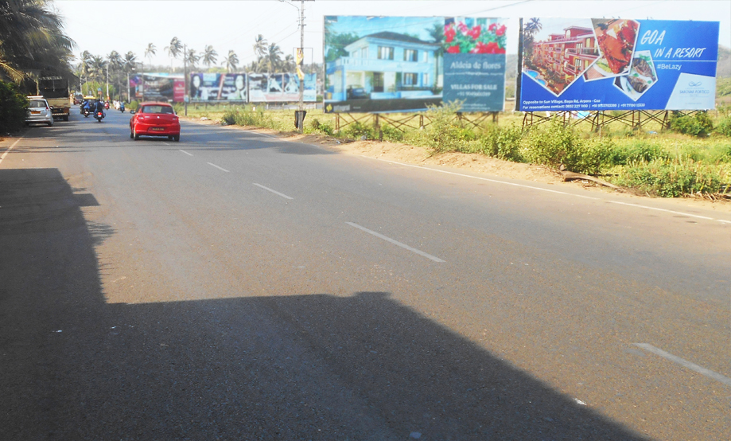
Baga entrance
(ftf Calangute to Anjuna) (50x20)
Billboard Rationale
High Traffic North Goa Tourist Area, visible to traffic & pedestrians entering into baga beach, calangute beach, candolim beach, sinquerim beach from mapusa, porvorim, panjim etc.
* (site very close to Club Cabana, Saturday Night Market, Titos, 3 star – 4 star properties such as Marina Dourada, Sunvillage, popular restaurants such
as Brittos, Little Italy, Souza Lobo etc)
Notes:
NOTE:
To change the image on this slide, select the picture and delete it. Then click the Pictures icon in the placeholder to insert your own image.

Slide 11
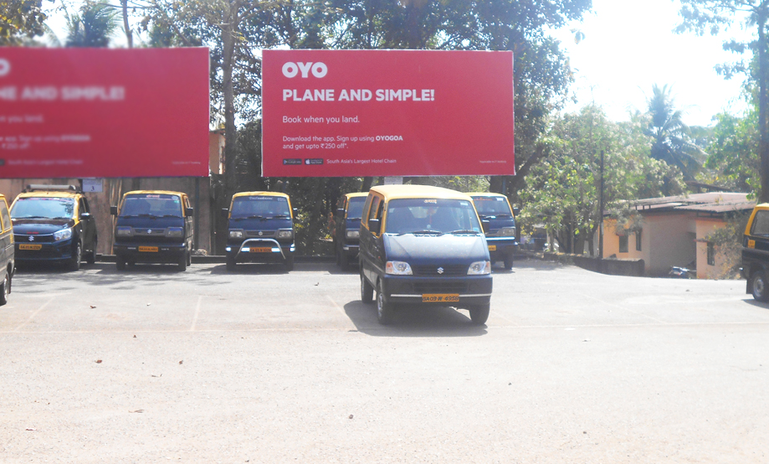
Thivim (outside railway station) (20x10)
Billboard Rationale
High Traffic Area, visible to traffic moving towards mapusa city, panjim city, calangute, baga, candolim from bicholim city.
* (site very close to tivim railway station, tivim industrial estate, sesa goa mines, area a residential hub of jewellers, miners, businessmen owning industrial sheds.
Very close to hyundai showroom)
Notes:
NOTE:
To change the image on this slide, select the picture and delete it. Then click the Pictures icon in the placeholder to insert your own image.

Slide 12
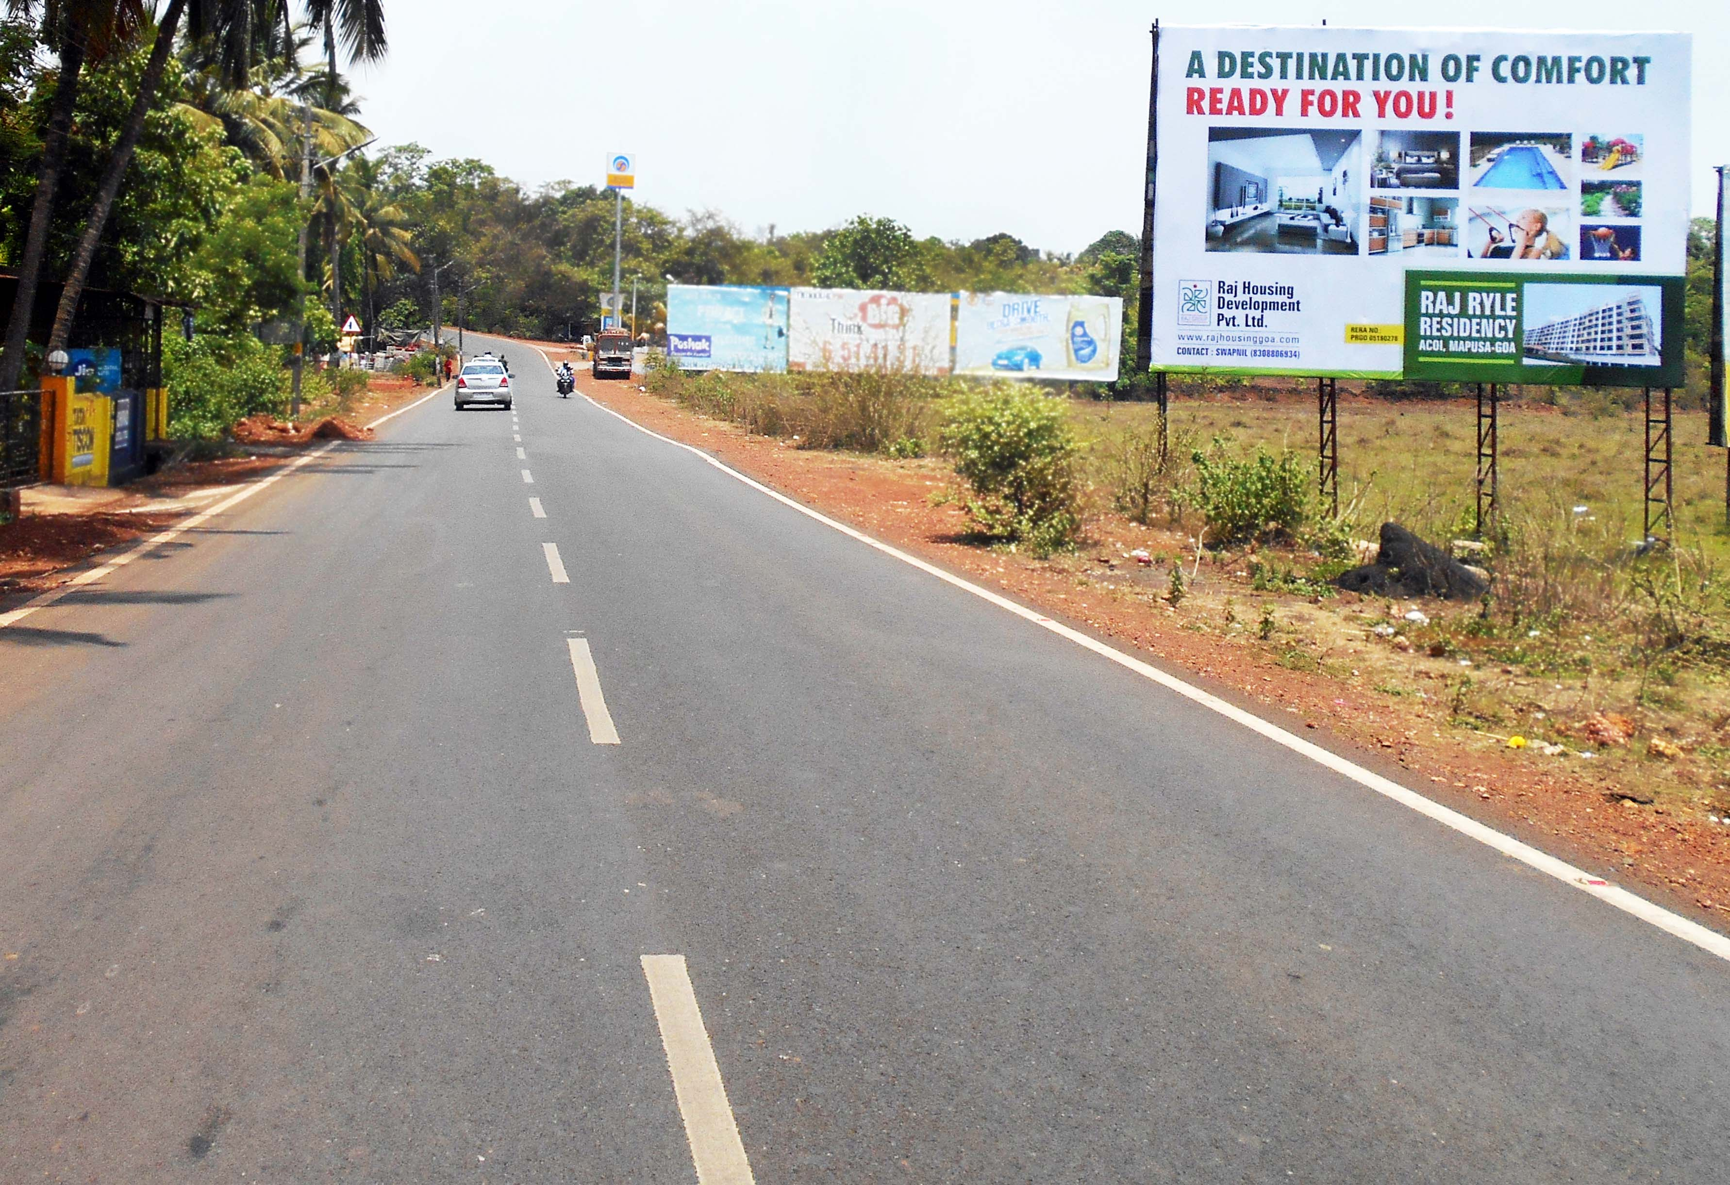
Tivim (outside railway station) ftf Bicholim
to Mapusa (30x20)
Billboard Rationale
High Traffic Area, visible to traffic moving towards Mapusa city, Panjim city, Calangute, Baga, Candolim from Bicholim city,.
* (Site very close to Tivim railway station, Tivim Industrial Estate, Sesa Goa Mines, area a residential hub of jewellers, miners, businessmen owning industrial sheds. Very close
to Hyundai showroom)
Notes:
NOTE:
To change the image on this slide, select the picture and delete it. Then click the Pictures icon in the placeholder to insert your own image.

Slide 13
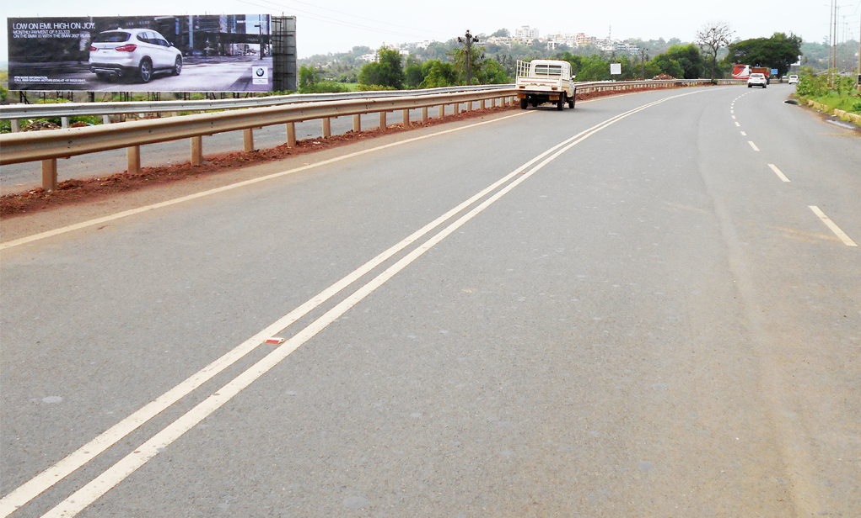
Merces ftf Panjim to Old Goa, Ponda (80x20)
Billboard Rationale
Very High Traffic Area, visible to traffic moving towards Old Goa, Ribandar, Kadamba Plateau.
Notes:
NOTE:
To change the image on this slide, select the picture and delete it. Then click the Pictures icon in the placeholder to insert your own image.

Slide 14
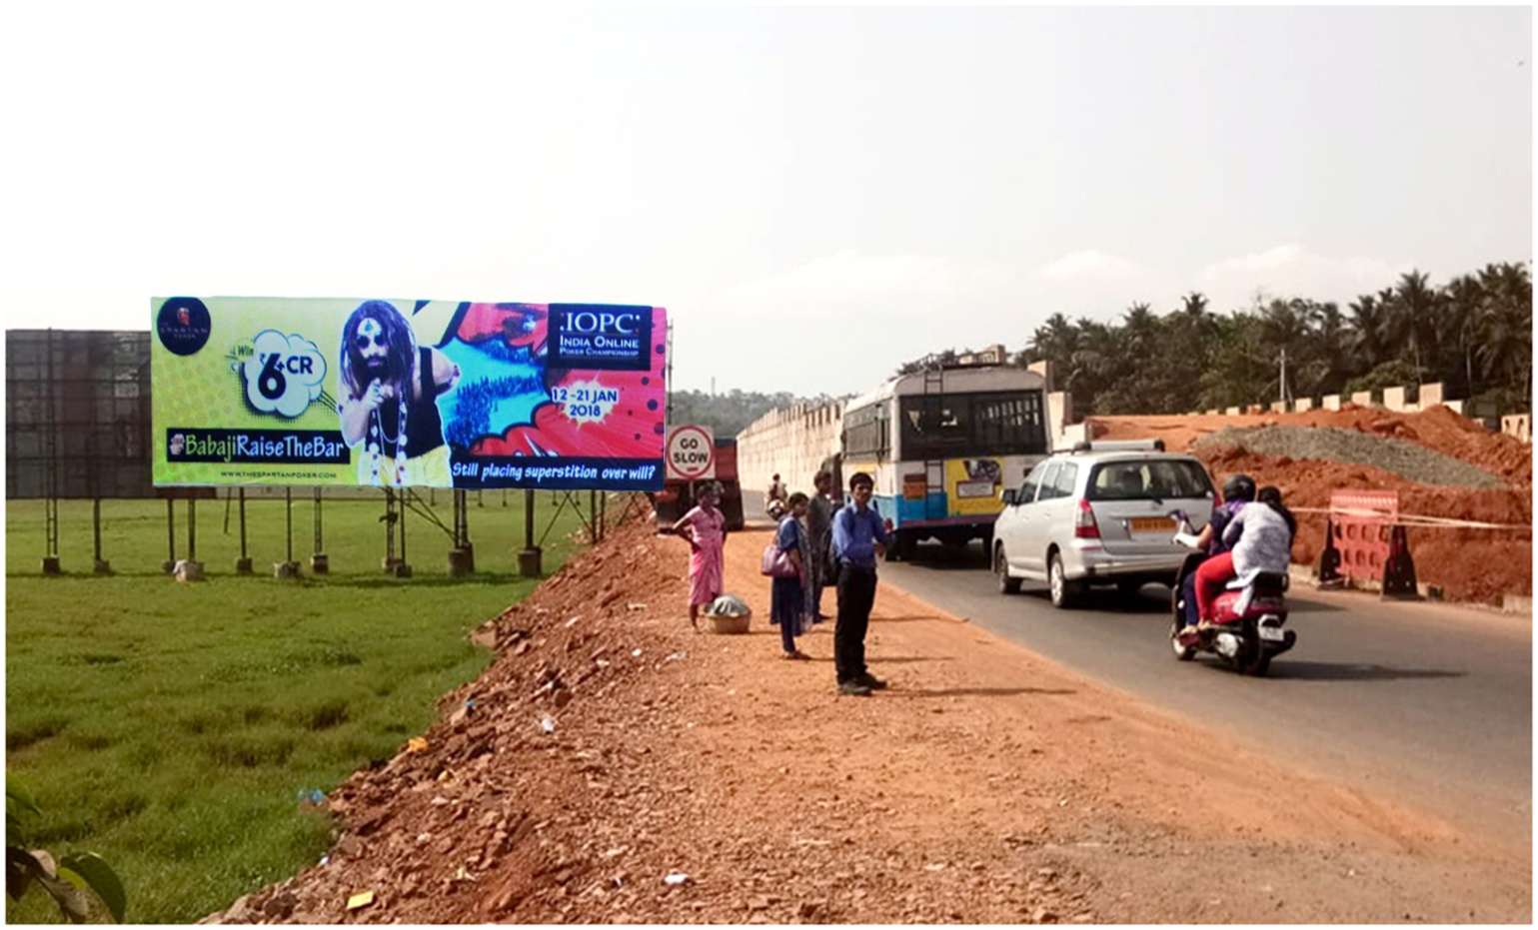
Bambolim (near Santacruz NH17 highway junction)
ftf Panjim to Margao, Vasco (airport) (55x20)
Billboard Rationale
Very High Traffic Area, visible to traffic moving towards airport, Margao city, Vasco city, Verna Industrial Estate from Panjim city, Mapusa city etc
* (Site near Niyaz biryani, site very close to Bambolim Cross, Goa Medical College and Hospital, Goa University & Nursing Home. Head on visibility)
Notes:
NOTE:
To change the image on this slide, select the picture and delete it. Then click the Pictures icon in the placeholder to insert your own image.

Slide 15
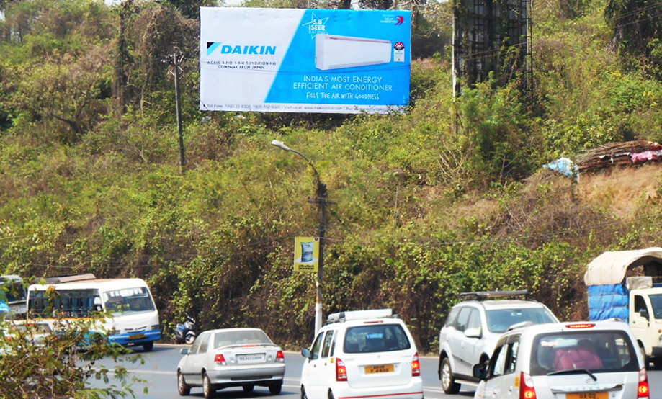
Bambolim (near slope) ftf Panjim to Margao, Vasco (airport) (40x20)
Billboard Rationale
Very High Traffic Area,
visible to traffic moving towards airport, margao city, vasco city, verna industrial
estate from Panjim city, mapusa city etc
* (Solus site very close to Bambolim Cross, Goa Medical College and hospital, Goa University & Nursing Home. Head on visibility)
Notes:
NOTE:
To change the image on this slide, select the picture and delete it. Then click the Pictures icon in the placeholder to insert your own image.

Slide 16
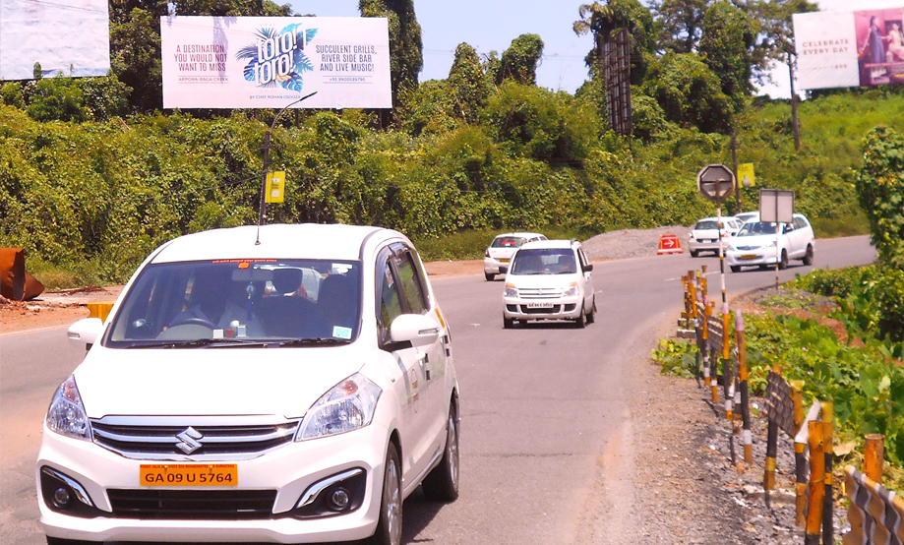
Bambolim (near slope ) ftf Margao,
Vasco (airport) to Panjim (51x20)
Billboard Rationale
Very High Traffic Area, visible to traffic moving towards Panjim city, Mapusa city from airport, Vasco city, Verna Industrial Estate, Margao city etc
* (Site very close to Goa Medical College & Hospital, Goa University )
Notes:
NOTE:
To change the image on this slide, select the picture and delete it. Then click the Pictures icon in the placeholder to insert your own image.

Slide 17
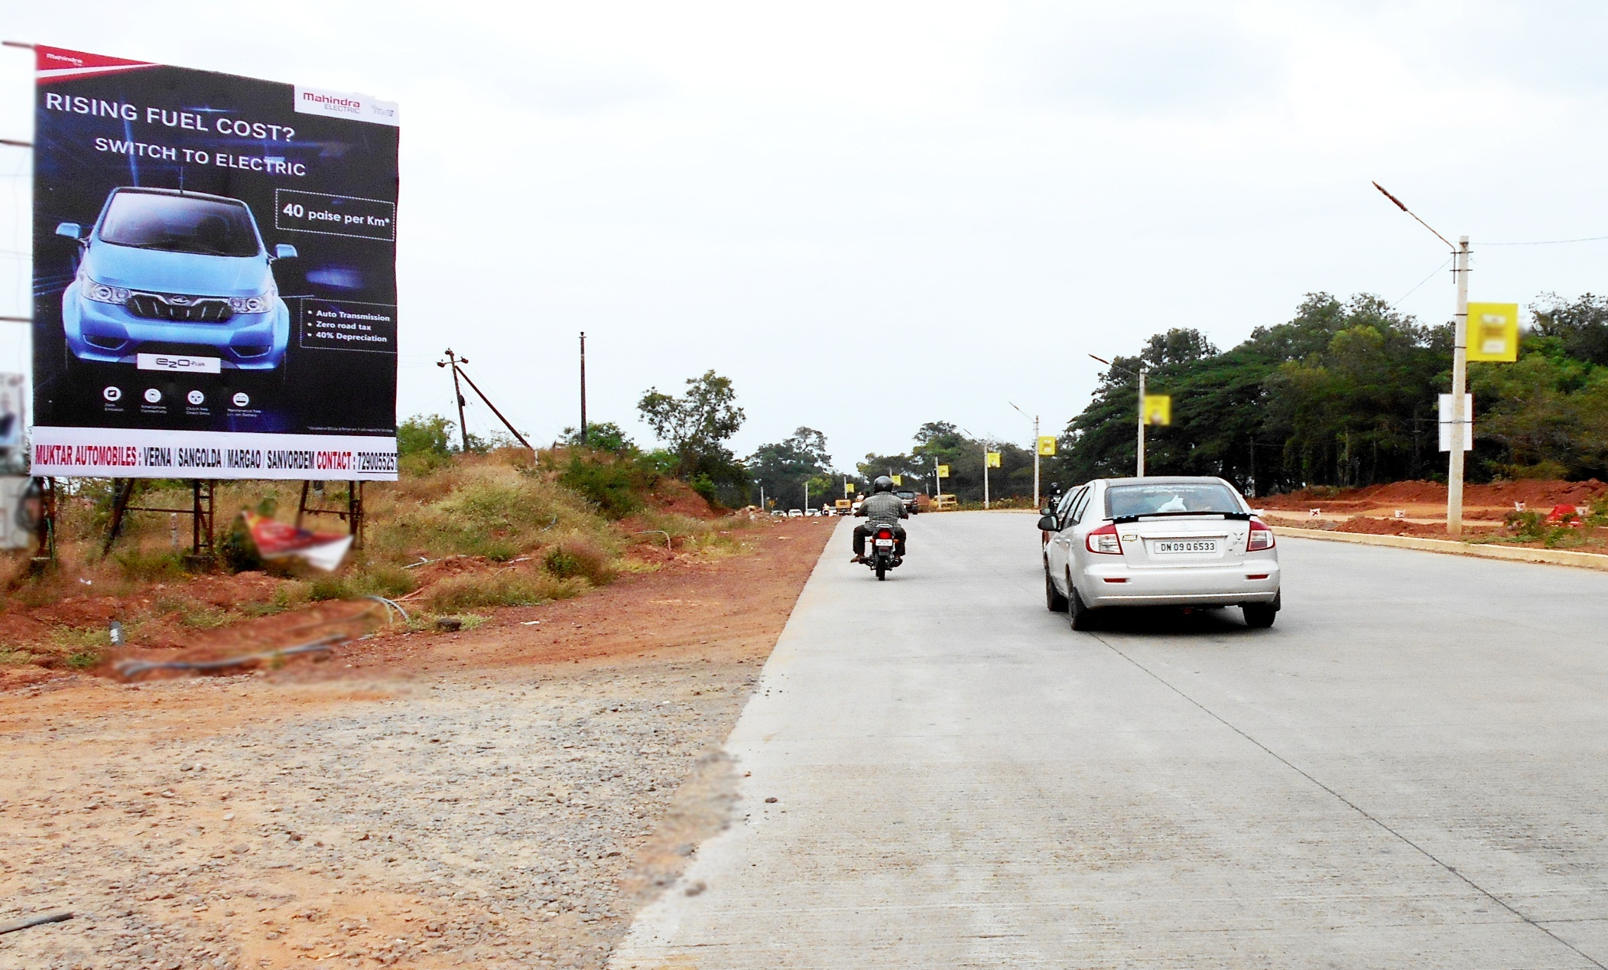
Bambolim ftf Margao,
Vasco (airport) to Panjim (20x25)
Billboard Rationale
Very High Traffic Area, visible to traffic moving towards Panjim city, Mapusa city from airport, Vasco city, Verna Industrial Estate, Margao city etc
* (Site very close to Goa Medical College & Hospital, Goa University, Coffee day etc )
Notes:
NOTE:
To change the image on this slide, select the picture and delete it. Then click the Pictures icon in the placeholder to insert your own image.

Slide 18
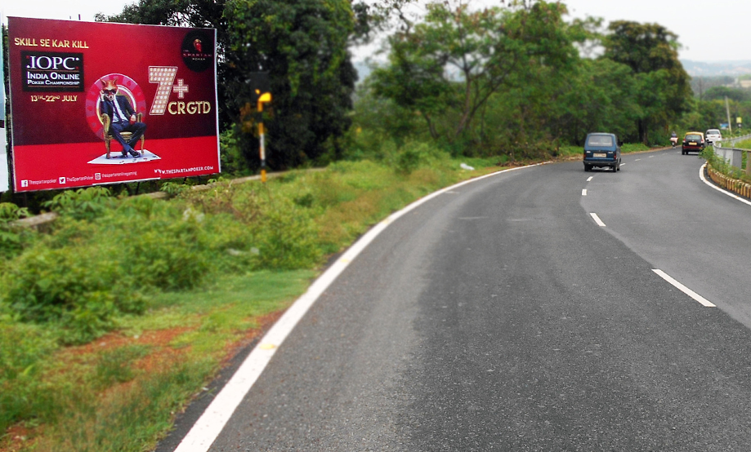
Bambolim ftf Margao,
Vasco (airport) to Panjim (opp Coffee day) (30x20)
Billboard Rationale
Very High Traffic Area, visible to traffic moving towards Panjim city, Mapusa city from airport, Vasco city, Verna Industrial Estate, Margao city etc
* (Site very close to Goa Medical College & Hospital, Goa University )
Notes:
NOTE:
To change the image on this slide, select the picture and delete it. Then click the Pictures icon in the placeholder to insert your own image.

Slide 19
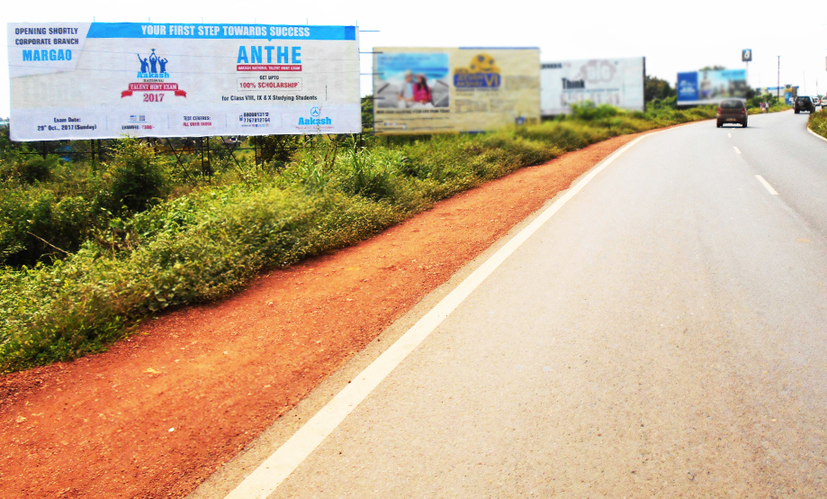
Keserval (near Verna Industrial Estate) ftf Panjim to Margao, Vasco (airport) (60x20)
Billboard Rationale
High Traffic Area – Industrial hub, visible to traffic entering into Margao city, Vasco city, Verna Industrial Estate from Panjim city,
Agassaim etc
* (Site near Toyota showroom very close to airport, Verna Industrial Estate, Bmw, Honda, Ford, Hyundai showrooms. Head on visibility)
Notes:
NOTE:
To change the image on this slide, select the picture and delete it. Then click the Pictures icon in the placeholder to insert your own image.

Slide 20
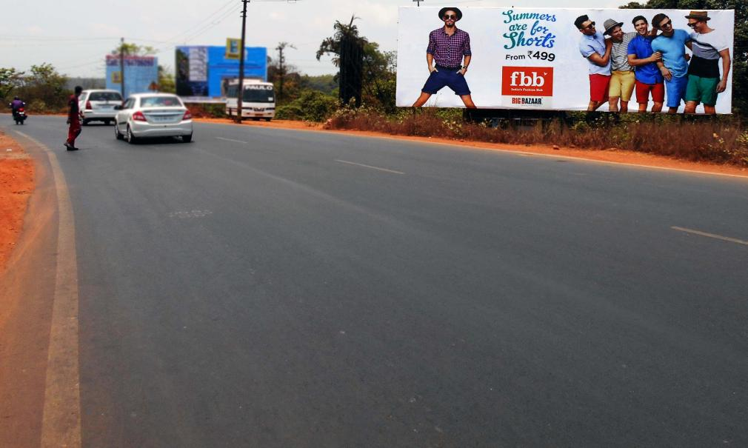
Keserval (near Verna Industrial Estate) ftf Margao, Vasco (airport) to Panjim (60x20)
Billboard Rationale
High Traffic Area – Industrial hub, visible to traffic entering into Agassaim, Panjim, Mapusa from Margao city, Vasco city, Verna Industrial Estate etc
* (Site bang opposite Toyota showroom , site very close to airport, Verna Industrial Estate, Bmw, Honda, Ford, Hyundai showrooms. Head on visibility)
Notes:
NOTE:
To change the image on this slide, select the picture and delete it. Then click the Pictures icon in the placeholder to insert your own image.

Slide 21
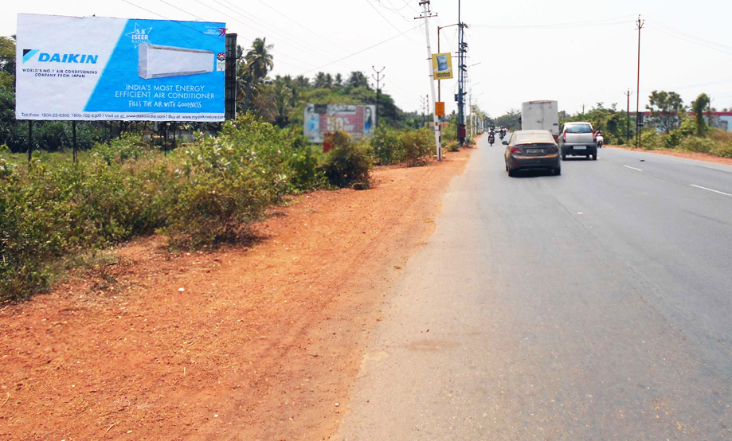
Verna (near Nagoa panchayat) ftf Panjim to Margao (39x20)
Billboard Rationale
High Traffic Area - Industrial hub, visible to traffic entering into Margao city from Panjim city, Vasco city, Agassaim etc
* (Site very close to airport, Verna Industrial Estate, Bmw, Honda, Ford, Mahindra, Hyundai showrooms. Bmw, Honda, Hyundai showrooms. Head on visibility)
Notes:
NOTE:
To change the image on this slide, select the picture and delete it. Then click the Pictures icon in the placeholder to insert your own image.

Slide 22
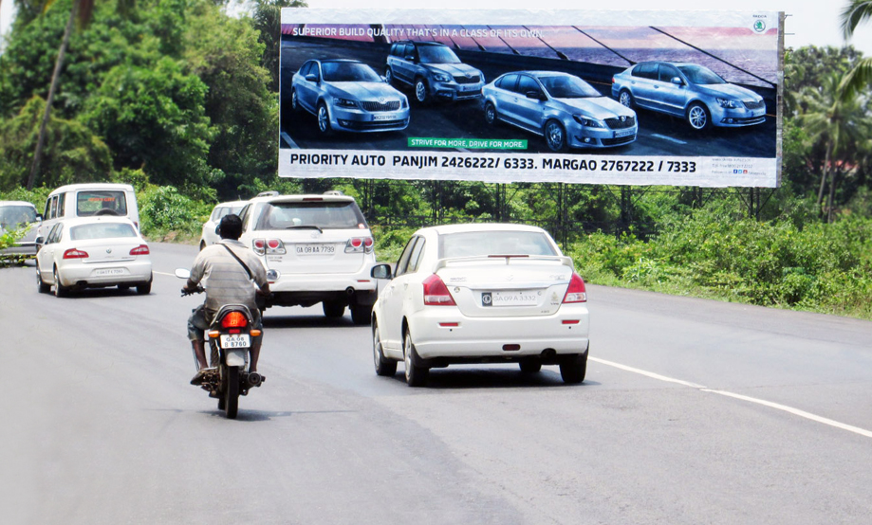
Margao entrance (90x30)
Billboard Rationale
High Traffic Area – Commercial hub, visible to traffic entering into Margao city from Panjim city, Vasco city, Verna Industrial Estate etc
* (Site bang at the entrance of Margao city, very close to Honda showroom, Inox, etc.)
Notes:
NOTE:
To change the image on this slide, select the picture and delete it. Then click the Pictures icon in the placeholder to insert your own image.

Slide 23
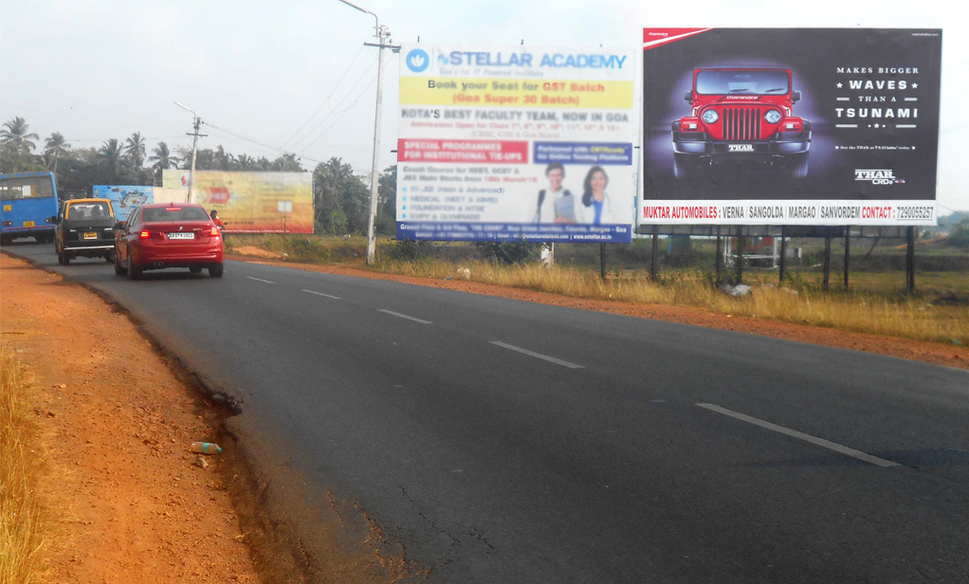
Margao city entrance (30x20)
Billboard Rationale
High Traffic Area – Commercial hub, visible to traffic entering into Margao city from Panjim city, Vasco city, Verna Industrial Estate etc
* (Site bang at the entrance of Margao city, very close to Honda showroom, Margao ktc bus stand, Osia Multiplex)
Notes:
NOTE:
To change the image on this slide, select the picture and delete it. Then click the Pictures icon in the placeholder to insert your own image.

Slide 24
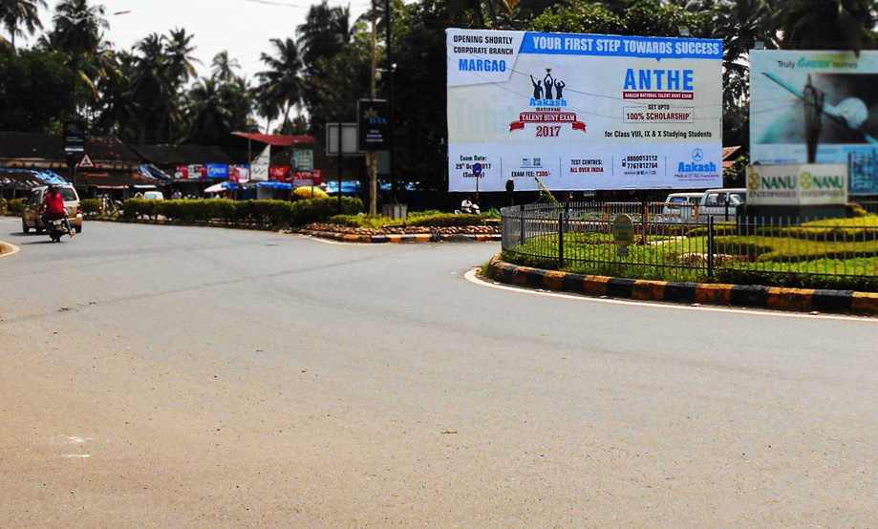
Margao city circle (60x30)
Billboard Rationale
High Traffic Area – Commercial hub, visible to traffic entering into Margao city from Panjim city,Vasco city, Verna Industrial Estate etc
* (Site bang at the entrance of Margao city, very close to Mathani Saldanha administrative complex and Honda showroom, Inox, etc.)
Notes:
NOTE:
To change the image on this slide, select the picture and delete it. Then click the Pictures icon in the placeholder to insert your own image.

Slide 25
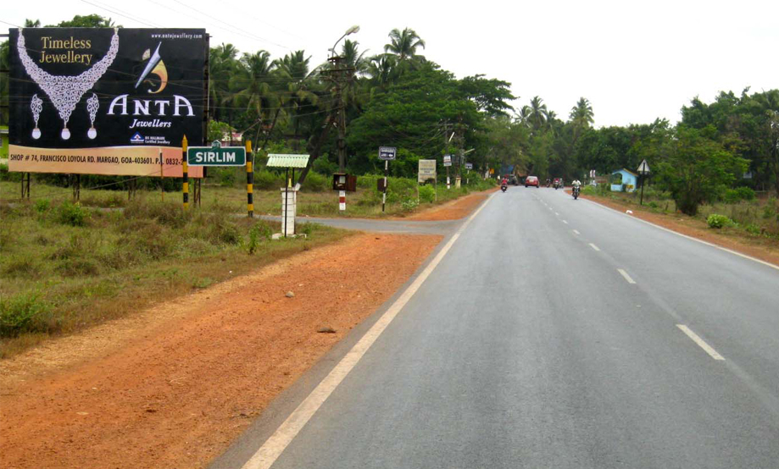
Goa entrance from karnataka, karwar, near sirlim (navelim) ftf canacona to margao (1) (30x20) (1)
Billboard Rationale
High Traffic Area – Commercial hub, visible to traffic entering into Margao city, Colva Beach, Benaulim, from Canacona & Karnataka.
Notes:
NOTE:
To change the image on this slide, select the picture and delete it. Then click the Pictures icon in the placeholder to insert your own image.

Slide 26
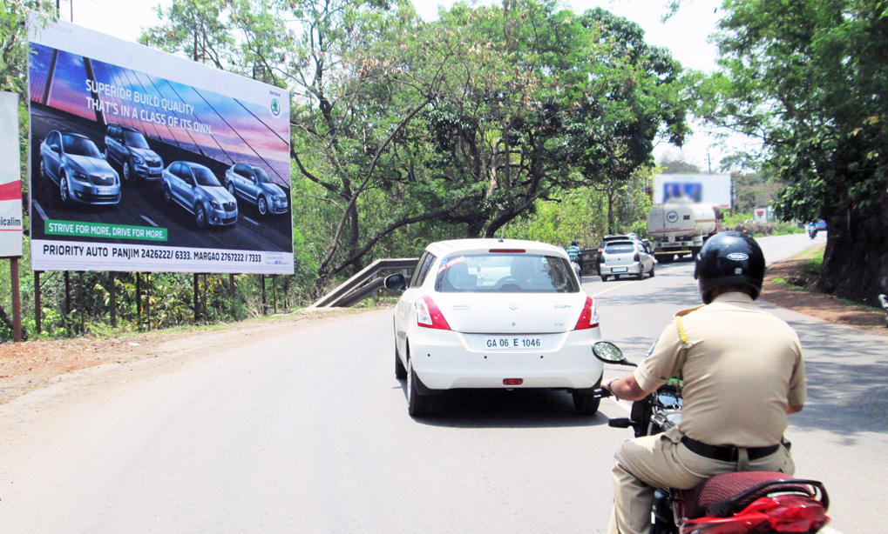
Vasco city entrance & exit (31x16)
Billboard Rationale
High Traffic Area – visible to traffic entering into Vasco city, airport.
* (Site very close to airport, Head on visibility)
Notes:
NOTE:
To change the image on this slide, select the picture and delete it. Then click the Pictures icon in the placeholder to insert your own image.

Slide 27
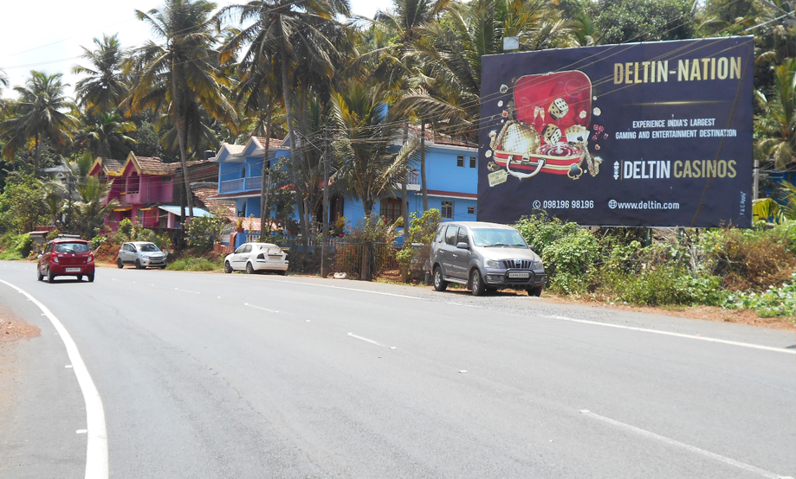
Vasco city (airport) to Panjim (32x20)
Billboard Rationale
High Traffic Area – Industrial hub, visible to traffic entering into Panjim city, from airport, Vasco city.
* (Site very close to Anderson Marine, Club Lava & Chowgule Showroom. Head on Visibility)
Notes:
NOTE:
To change the image on this slide, select the picture and delete it. Then click the Pictures icon in the placeholder to insert your own image.

Slide 28
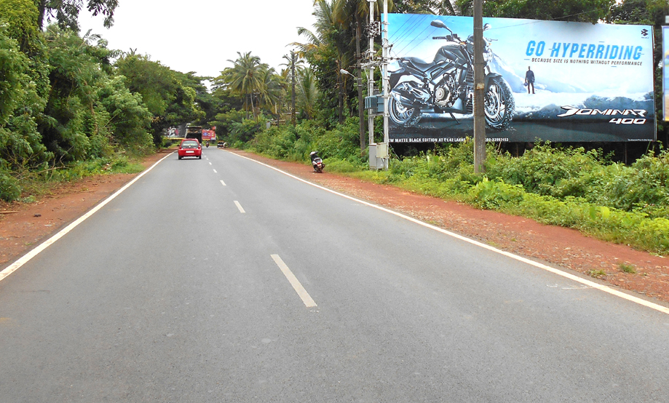
Vasco city (airport) to Panjim (60x25)
Billboard Rationale
High Traffic Area – Industrial hub, visible to traffic entering into Panjim city, from airport, Vasco city.
* (Site very close to Anderson Marine, Club Lava & Chowgule Showroom. Head on Visibility)
Notes:
NOTE:
To change the image on this slide, select the picture and delete it. Then click the Pictures icon in the placeholder to insert your own image.

Slide 29
www.thinkbig.pw
455, Anthony Villa, Abaixo vaddo,
Canca – Parra, Bardez
Goa - 403510
Tel: 08322472141
Mob: 9764754567|7378883171 |7378883191
Email: thinkbigadvtg1@gmail .com
Website: www.thinkbig.pw

